Slide 1
Reference Dashboards

Slide 2
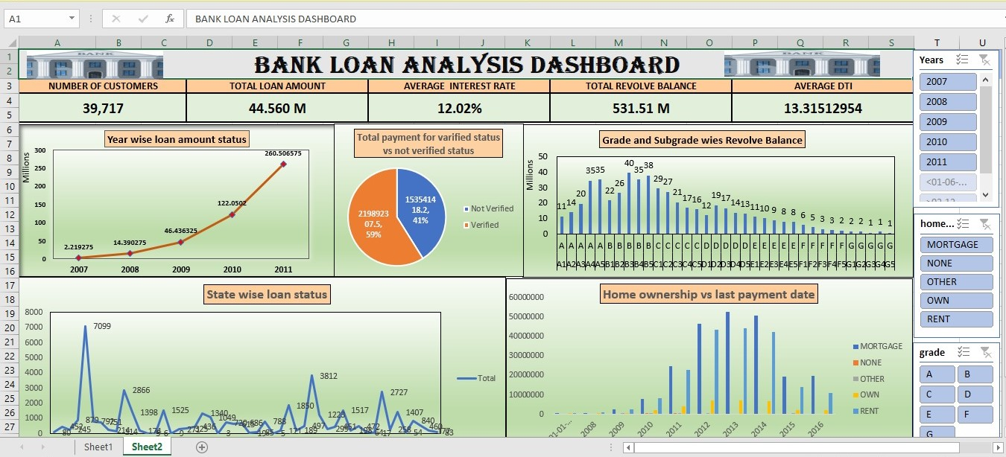
EXCEL DASHB0ARD

Slide 3
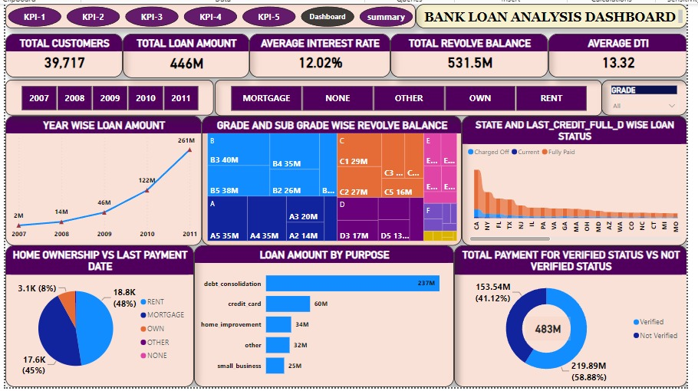
POWER BI DASHBOARD

Slide 4
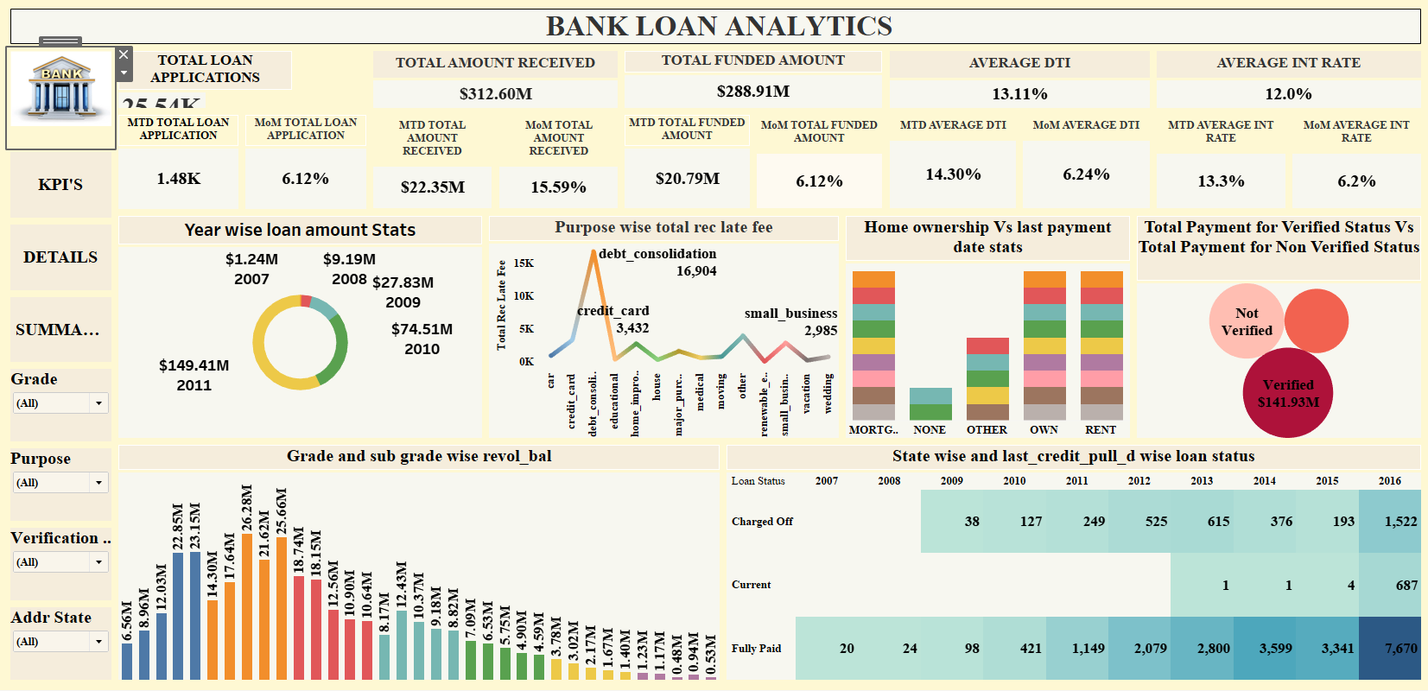
TABLEAU DASHBOARD
TABLEAU DASHBOARD

